Slide 1
‘Toxic Workplaces’ – Handling a new era of disputes
Claire scott – partner
Lisa byars –director
Notes:
NOTES:

Slide 2


Managing ‘toxic workplaces’
Notes:
NOTES:

Slide 3
A new era of litigation…
Claims of toxic workplaces, bullying and harassment
Litigation using AI
Multiple respondents
Interim relief applications for whistleblowing
Crowd funding of litigation
High profile cases being litigated in the media
Social media campaigns
Knock on effects for other employers
Notes:
NOTES:

Slide 4
The Legal backdrop
Equality Act 2010
Age
Disability
Gender reassignment
Marriage and civil partnership
Race
Religion or belief
Sex
Sexual orientation
Pregnancy and maternity
Direct, indirect discrimination
Harassment and victimisation
Protection from Harassment Act 1997
Employment Rights Act 1996
Public Interest Disclosure Act 1998
And now the Employment Rights Bill…
Notes:
NOTES:

Slide 5
An Example - Clashing beliefs
Notes:
NOTES:

Slide 6
‘Belief’ in the Equality Act 2010
Grainger plc v Nicholson [2010] IRLR 4
No express definition in the Equality Act
Open-ended approach allowing for broad interpretation
The Grainger criteria: ‘philosophical beliefs’
The belief must be genuinely held;
It must be a belief and not, an opinion or viewpoint based on a present state of information available;
It must be a belief as to a weighty and substantial aspect of human life and behavior;
It must attain a certain level of cogency, seriousness, cohesion and importance;
It must be worthy of respect in a democratic society, be not incompatible with human dignity and not with the fundamental rights of others.
Gender-critical beliefs as ‘philosophical beliefs’
Notes:
NOTES:

Slide 7
For Women Scotland v Scottish Ministers [2025]
Supreme Court held:
The definitions of “woman”, “man” and “sex” in the Equality Act 2010 refer to biological sex
The definition of “woman” therefore excludes trans women holding a gender recognition certificate., who remain protected under the protected characteristic of gender reassignment or in relation to their biological sex (or perceived biological sex).
Where are we now?
Notes:
NOTES:

Slide 8
Dangers of a clash of beliefs
Legal Risk
Claims brought under the Equality Act 2010
Reputational risk
High-profile cases can be extremely damaging to an employer’s reputation
Employee relations and engagement risk
Failure to adequately manage conflicts may lead to employees to feel their views are not valued in the workplace
Notes:
NOTES:

Slide 9
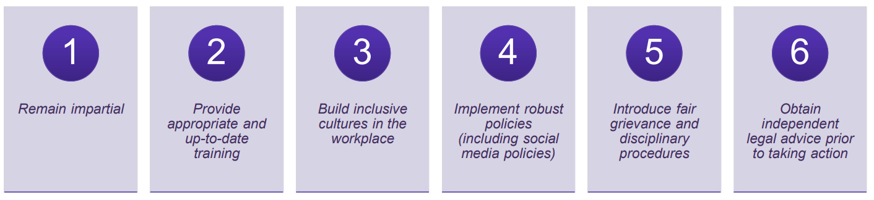
Mitigating the risks
Notes:
NOTES:

Slide 10
Investigating allegations of a toxic workplace
Notes:
NOTES:

Slide 11
When to investigate?
Alleged misconduct e.g. bullying and harassment or discrimination
Grievances
Whistleblowing
Regulatory concerns
Cultural issues
Multiple complaints
External complaints
Notes:
NOTES:

Slide 12
Why Investigate?
Demonstrates a fair process for purposes of ET claims.
Sets standards for conduct
Increases likelihood of matters being resolved appropriately
Creates a consistent approach when dealing with issues
How employers handle investigations makes a lasting impression on staff
Notes:
NOTES:

Slide 13
Choosing the Investigator
Qualities to look for:
Patient
Good listener
Analytical and methodical
Investigators must have:
Time
Lack of bias
Support from HR and others
Previous experience / training on conducting investigations where possible
Notes:
NOTES:

Slide 14
The Role of the Investigator
Remain fair and objective
Keep an open mind
Determine the scope of the investigation
Review all the evidence
Establish the essential facts of the matter
Keep records of all investigation meetings held
Reach a conclusion on what did or did not happen
Complete a report presenting the factual findings
Notes:
NOTES:

Slide 15
Interplay with Regulatory Obligations and Criminal Proceedings
Consider any obligations to a regulator
Each regulator will impose their own reporting requirement
Consult the relevant rules which apply before launching into an investigation.
Consider any ongoing criminal process – have you been advised to pause or proceed?
Notes:
NOTES:

Slide 16
Historic Complaints
Me Too movement increasing likelihood of historic complaints
Leads to increased challenges when investigating as people’s recollection of events inevitably fades over time
How credible is old evidence?
Witnesses who no longer work for the employer?
Hostile witnesses?
Notes:
NOTES:

Slide 17
Legal Advice Privilege
The right to keep confidential, communications between legal counsel and a client where the communication is made confidentially for the dominant purpose of giving or receiving legal advice.
“Legally privileged” documents will not usually need to be disclosed to a third party or as part of any court proceedings
University of Dundee v Chakraborty
Notes:
NOTES:

Slide 18
Pitfalls to avoid with investigations
Ignoring complaints
Delayed responses
Inadequate investigation
Lack of support
Inconsistent policy enforcement
Inadequate training
Not thinking carefully enough about who should investigate and legal privilege
Notes:
NOTES:

Slide 19
Top tips for employers
Policies and procedures
The role of D&I and Leadership from the top
Effective training and coaching
Encourage communication
Take complaints seriously
Don’t shy away from ongoing management – but remember support for all!
Don’t forget SOSR
Early strategic legal advice for high-risk cases
Notes:
NOTES:

Slide 20
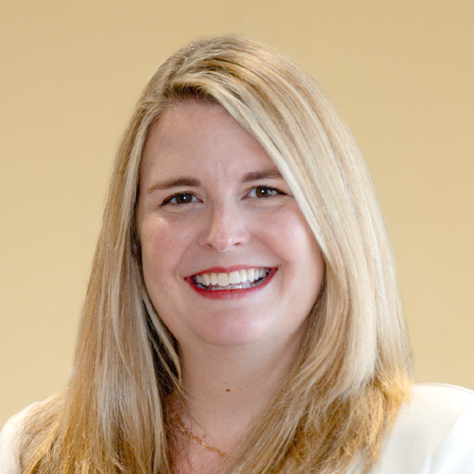
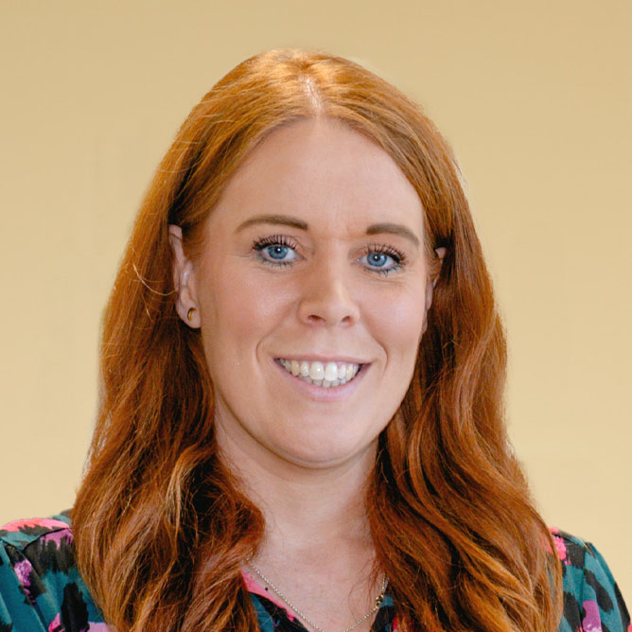
Claire Scott
Lisa Byars
PARTNER
director
+44 (0)1224 261229
+44 (0)7881 899 767
claire.scott@burnesspaull.com
+44 (0)1224 261243
+44 (0)7386 952 858
lisa.byars@burnesspaull.com
Notes:
NOTES:

Slide 21
Notes:
NOTES:

