Slide 1
‘Toxic Workplaces’ – Handling a new era of disputes
Claire scott – partner
Lisa byars –director

Slide 2


Managing ‘toxic workplaces’

Slide 3
A new era of litigation…
Claims of toxic workplaces, bullying and harassment
Litigation using AI
Multiple respondents
Interim relief applications for whistleblowing
Crowd funding of litigation
High profile cases being litigated in the media
Social media campaigns
Knock on effects for other employers

Slide 4
The Legal backdrop
Equality Act 2010
  Age
  Disability
  Gender reassignment
  Marriage and civil partnership
  Race
  Religion or belief
  Sex
  Sexual orientation
  Pregnancy and maternity
Direct, indirect discrimination
Harassment and victimisation
Protection from Harassment Act 1997
Employment Rights Act 1996
Public Interest Disclosure Act 1998
And now the Employment Rights Bill…

Slide 5
‘Belief’ in the Equality Act 2010
Grainger plc v Nicholson [2010] IRLR 4
No express definition in the Equality Act
Open-ended approach allowing for broad interpretation
The Grainger criteria: ‘philosophical beliefs’
  The belief must be genuinely held;
  It must be a belief and not, an opinion or viewpoint based on a present state of information available;
  It must be a belief as to a weighty and substantial aspect of human life and behavior;
  It must attain a certain level of cogency, seriousness, cohesion and importance;
  It must be worthy of respect in a democratic society, be not incompatible with human dignity and not with the fundamental rights of others.
Gender-critical beliefs as ‘philosophical beliefs’

Slide 6
An Example - Clashing beliefs

Slide 7
Higgs v Farmor’s School [2025] EWCA Civ 109
Claimant is a Christian who worked as a pastoral administrator and work experience manager for the school.
Dismissed for gross misconduct following the school receiving a complaint about posts made by her on Facebook.
The posts included statements such as “they are brainwashing our children…children will be taught that all relationships are equally valid and ‘normal’…and that gender is a matter of choice” and “the LGBT [sic] crowd…are destroying the minds of normal children by promoting mental illness”.
The Claimant brought claims against the school, including for direct discrimination on the grounds of protected beliefs.

Slide 8
Higgs continued…
Employment Tribunal
  Claimant’s beliefs were protected.
  Dismissal not because of beliefs.
Employment Appeal Tribunal
  There was a close direct connection between the Facebook posts and the Claimant’s beliefs.
  A proportionality assessment of the decision to dismiss is necessary.
Court of Appeal
  Decision to dismiss was not a proportionate sanction for her conduct. Claim upheld.
Relevance to employers?

Slide 9
For Women Scotland v Scottish Ministers [2025]
Supreme Court held:
The definitions of “woman”, “man” and “sex” in the Equality Act 2010 refer to biological sex
The definition of “woman” therefore excludes trans women holding a gender recognition certificate., who remain protected under the protected characteristic of gender reassignment or in relation to their biological sex (or perceived biological sex).
Where are we now?

Slide 10
Dangers of a clash of beliefs
Legal Risk
Claims brought under the Equality Act 2010
Reputational risk
High-profile cases can be extremely damaging to an employer’s reputation
Employee relations and engagement risk
Failure to adequately manage conflicts may lead to employees to feel their views are not valued in the workplace

Slide 11
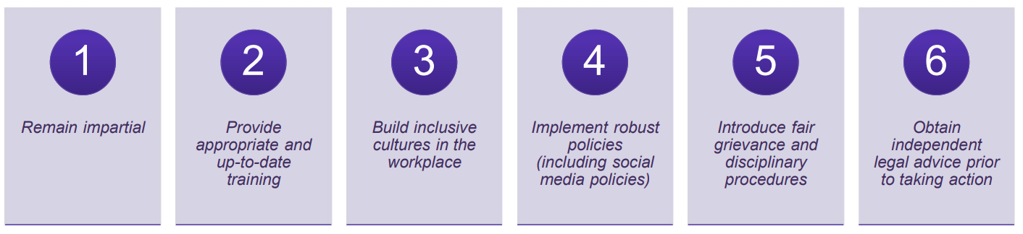
Mitigating the risks

Slide 12
Investigating allegations of a toxic workplace

Slide 13
When to investigate?
Alleged misconduct e.g. bullying and harassment or discrimination
Grievances
Whistleblowing
Regulatory concerns
Cultural issues
Multiple complaints
External complaints

Slide 14
Why Investigate?
Demonstrates a fair process for purposes of ET claims.
Sets standards for conduct
Increases likelihood of matters being resolved appropriately
Creates a consistent approach when dealing with issues
How employers handle investigations makes a lasting impression on staff

Slide 15
Choosing the Investigator
Qualities to look for:
  Patient
  Good listener
  Analytical and methodical
Investigators must have:
  Time
  Lack of bias
  Support from HR and others
  Previous experience / training on conducting investigations where possible

Slide 16
The Role of the Investigator
Remain fair and objective
Keep an open mind
Determine the scope of the investigation
Review all the evidence
Establish the essential facts of the matter
Keep records of all investigation meetings held
Reach a conclusion on what did or did not happen
Complete a report presenting the factual findings

Slide 17
Interplay with Regulatory Obligations and Criminal Proceedings
Consider any obligations to a regulator
Each regulator will impose their own reporting requirement
Consult the relevant rules which apply before launching into an investigation.
Consider any ongoing criminal process – have you been advised to pause or proceed?

Slide 18
Historic Complaints
Me Too movement increasing likelihood of historic complaints
Leads to increased challenges when investigating as people’s recollection of events inevitably fades over time
  How credible is old evidence?
  Witnesses who no longer work for the employer?
  Hostile witnesses?

Slide 19
Legal Advice Privilege
The right to keep confidential, communications between legal counsel and a client where the communication is made confidentially for the dominant purpose of giving or receiving legal advice.
“Legally privileged” documents will not usually need to be disclosed to a third party or as part of any court proceedings
University of Dundee v Chakraborty

Slide 20
Pitfalls to avoid with investigations
Ignoring complaints
Delayed responses
Inadequate investigation
Lack of support
Inconsistent policy enforcement
Inadequate training
Not thinking carefully enough about who should investigate and legal privilege

Slide 21
Top tips for employers
Policies and procedures
The role of D&I and Leadership from the top
Effective training and coaching
Encourage communication
Take complaints seriously
Don’t shy away from ongoing management – but remember support for all!
Don’t forget SOSR
Early strategic legal advice for high-risk cases

Slide 22
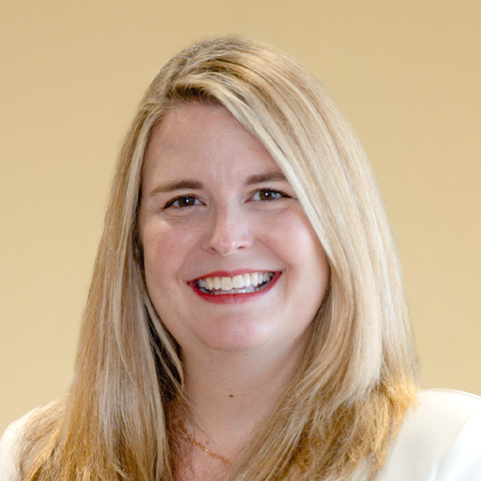
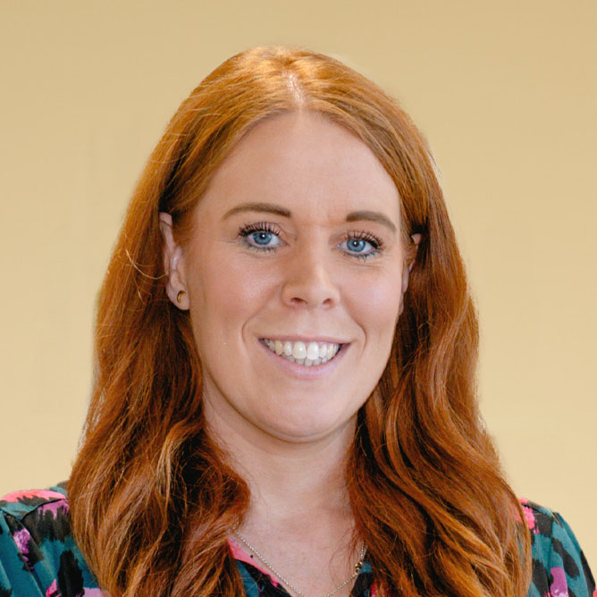
Claire Scott
Lisa Byars
PARTNER
director
+44 (0)1224 261229
+44 (0)7881 899 767
claire.scott@burnesspaull.com
+44 (0)1224 261243
+44 (0)7386 952 858
lisa.byars@burnesspaull.com

